Slide 1
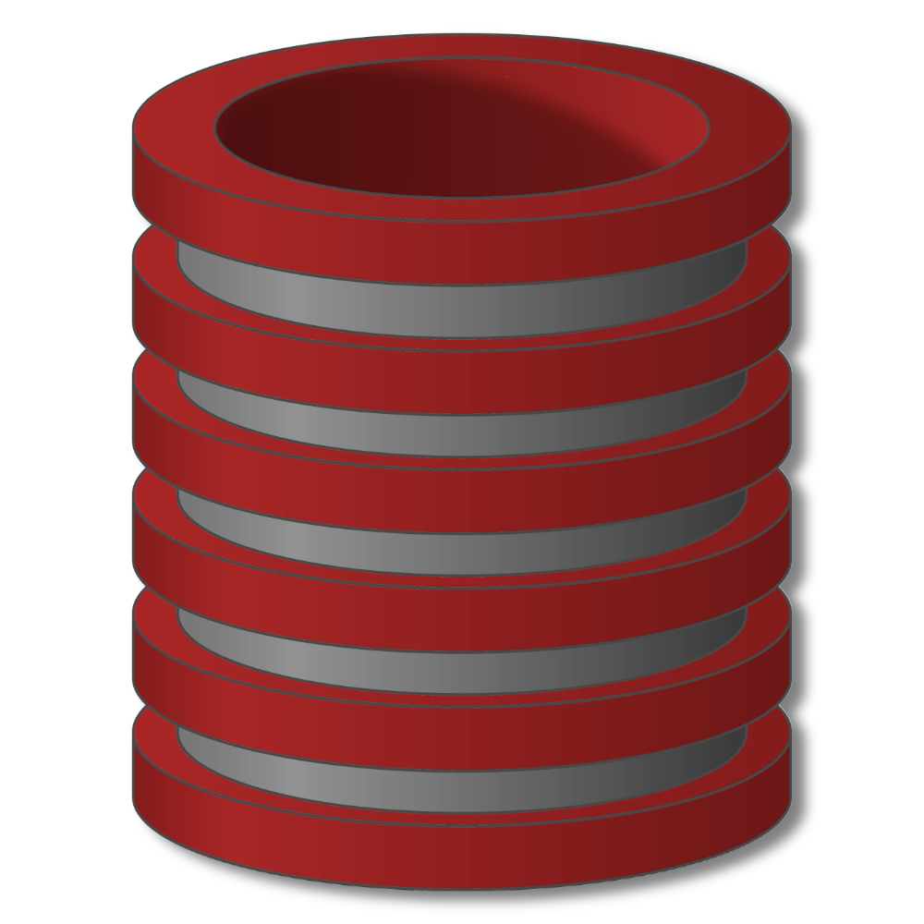
Indexes

Slide 2
Indexes
Indexes
Primary mechanism to get improved performance
on a database
Persistent data structure, stored in database
Many interesting implementation issues
But we are focusing on user/application perspective

Slide 3
Indexes
Functionality
T
Index
on T.A
 | A | B | C
1 | cat | 2 | …
2 | dog | 5 | …
3 | cow | 1 | …
4 | dog | 9 | …
5 | cat | 2 | …
6 | cat | 8 | …
7 | cow | 6 | …
 | … | … | …

Slide 4
Indexes
Functionality
T
Index
on T.A
 | A | B | C
1 | cat | 2 | …
2 | dog | 5 | …
3 | cow | 1 | …
4 | dog | 9 | …
5 | cat | 2 | …
6 | cat | 8 | …
7 | cow | 6 | …
 | … | … | …
Index
on T.B

Slide 5
Indexes
Functionality
T
Index
on T.A
 | A | B | C
1 | cat | 2 | …
2 | dog | 5 | …
3 | cow | 1 | …
4 | dog | 9 | …
5 | cat | 2 | …
6 | cat | 8 | …
7 | cow | 6 | …
 | … | … | …
Index
on T.(A,B)
Index
on T.B

Slide 6
Indexes
Utility
Index = difference between full table scans and
immediate location of tuples
Orders of magnitude performance difference
Underlying data structures
Balanced trees (B trees, B+ trees)
Hash tables

Slide 7
Indexes
Select sName
From Student
Where sID = 18942
Many DBMS’s build indexes automatically on
PRIMARY KEY (and sometimes UNIQUE) attributes

Slide 8
Indexes
Select sID
From Student
Where sName = ‘Mary’ And GPA > 3.9

Slide 9
Indexes
Select sName, cName
From Student, Apply
Where Student.sID = Apply.sID

Slide 10
Indexes
Downsides of Indexes
1)
2)
3)

Slide 11
Indexes
Picking which indexes to create
Benefit of an index depends on:
Size of table (and possibly layout)
Data distributions
Query vs. update load

Slide 12
Indexes
“Physical design advisors”
Input: database (statistics) and workload
Output: recommended indexes
Database statistics
Query Optimizer
Query or update
Indexes
Best execution plan
with estimated cost

Slide 13
Indexes
SQL Syntax
Create Index IndexName on T(A)
Create Index IndexName on T(A1,A2,…,An)
Create Unique Index IndexName on T(A)
Drop Index IndexName

Slide 14
Indexes
Indexes
Primary mechanism to get improved performance
on a database
Persistent data structure, stored in database
Many interesting implementation issues
But we are focusing on user/application perspective

